Slide 1

Online survey sampling solutions for studies of LGB
Presented by J. Michael Dennis, Ph.D., Managing Director, Government & Academic Research, GfK
CCBAR 2013 Annual Meeting Agenda
Thursday, October 17th, 2013
The University Club of Chicago
Meeting on “Biosocial Study of Health and Aging in Lesbian, Gay, Bisexual, and HIV-Affected Populations”

Slide 2
About GfK’s Government & Academic Research Team
2
Knowledge Networks (then “InterSurvey’’) was founded in 1998 in Menlo Park, CA
      KnowledgePanel recruitment started in summer 1999
      First federally funded studies in early 2000
Knowledge Networks acquired by GfK Custom Research in January 2012
    GfK’s Government & Academic Research and Sampling Statistics (legacy Knowledge Networks) includes:
      More than 40 experienced staff members in Palo Alto CA, Chicago IL, Washington DC, and New York NY.
      Conducts approximately 40 online surveys a month for major universities, government agencies, and non-profit organizations, with a broad mix of KnowledgePanel studies, custom online surveys using cross-sectional samples, and custom panel studies
      Sampling Statistics staff are integrated organizationally with the Government & Academic Research staff, bringing sampling and weighting expertise into each study
      Closely connected to KnowledgePanel Operations
Notes:
2
2
KN was built on an academic foundation. Statistical and sampling theory are the foundation of our work.
2

Slide 3
Sampling Solutions

Slide 4
Probability-based Web panels for Social Science, Health and Medical, and Policy Research
  Recruited with probability samples (no non-sampled volunteers)
  Area-based, in-person methods
    Random-digit dial (RDD)
    Dual frame samples of RDD with a cell phone component
    Address-based sampling (ABS)
  Panel members have known selection probability
  Accounted in panel member’s base weight
    All sampling frame units have a non-zero chance of being recruited
  Due to recruitment costs, current panels tend to be of modest size (range 2,000-60,000 adult research subjects).
4

Slide 5
American Association for Public Opinion Research
Online Task Force Key Recommendations (2010)
Researchers should avoid nonprobability online panels when one of the research objectives is to accurately estimate population values.
Empirical research to date comparing the accuracy of surveys using nonprobability online panels with that of probability-based methods finds that the former are generally less accurate when compared to benchmark data from the Census or administrative records. From a total survey error perspective, the principal source of error in estimates from these types of sample sources is a combination of the lack of Internet access in roughly one in three U.S. households and the self-selection bias inherent in the panel recruitment processes.
GfK offers the only probability-based U.S. online panel, KnowledgePanel
Citation: “AAPOR Report on Online Panels,” prepared by the AAPOR Online Task Force Report, March 2010. Available at www.aapor.org

Slide 6

60,000 members
representing America
Probability-based recruitment, representative of U.S. adult population
      Includes:
  Households with no Internet access at time of recruitment
    29% of U.S. households have no Internet access¹ – GfK provides netbook computer, free monthly ISP
  Cell phone only households (35.8% of U.S.²) through ABS mail recruitment
  Spanish-language households
  Extensive profile data maintained on member demographics, attitudes, opinions, behaviors, media usage, etc.
  Samples from the panel are assigned to studies using e-mail invitations and a link to the online survey questionnaire
¹U.S. Census Bureau, Current Population Survey School Enrollment and Internet Use Supplement, October 2010.
²Blumberg SJ, Luke JV. Wireless substitution: Early release of estimates from the National Health Interview Survey, January–June 2012. National Center for Health Statistics. December 2012. Available from: http://www.cdc.gov/nchs/nhis.htm.
6

Slide 7
Key Differentiators of KnowledgePanel
7
7
Only probability-based web panel where:
  All surveys administered online
  Covers all age groups 18+, non-Internet adults, cell only adults
  Includes Spanish-language-dominant Hispanic households
  Probability structure allows for projectable population estimates
  Valid confidence intervals (margins of error) can be constructed
Lower costs because study subjects are already recruited and profiled
  GfK conducts up to 15 annual profile surveys to aid in pre-identified sampling, prevalence estimations and secondary data analysis
  Existing profile data can be added to any client survey data with minimal impact on cost

Slide 8
Solution: Address-based Sample (ABS)
Mail & Telephone-based Recruitment
8
U.S. Postal Service Delivery Sequence File (DSF)
  ~97% coverage of physical addresses
  Frequently updated including status of addresses, such as, seasonal homes, vacant houses, etc.
  Can be matched to available telephone numbers
  Can be geo-coded
  Can attach demographic data (actual and modeled) from a variety of sources (e.g., block-level Census data) for purposes of
    Non-response analyses
    Targeted demographic mailings
Notes:
8
The uncovered 3% tend to be households on rural routes and in very large apartment buildings where there is not an apartment number, but instead a supervisor that hand distributes the mail.

Slide 9


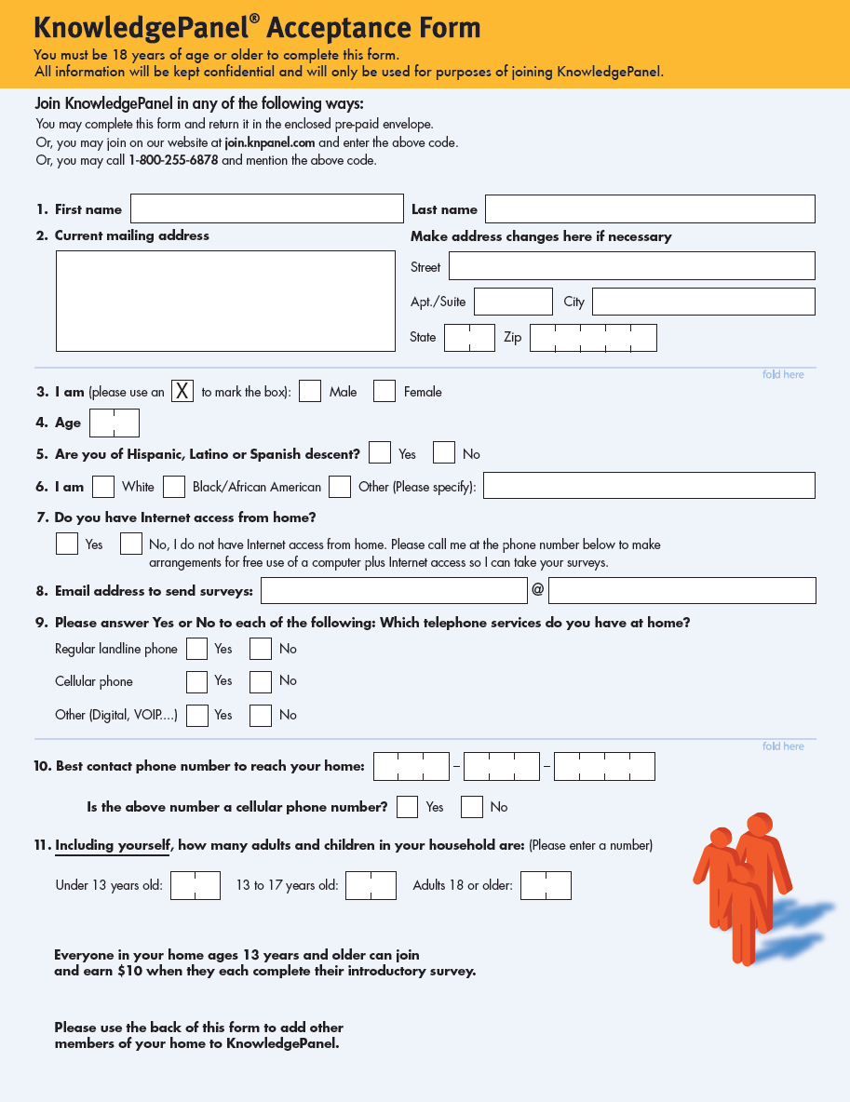




At some point we will need to update these with newly branded images for GfK
Current Resident / Residente Actual
123 Your Street
The City, State 99999
Current Resident / Residente Actual
123 Your Street
The City, State 99999
9
Notes:
9
9

Slide 10
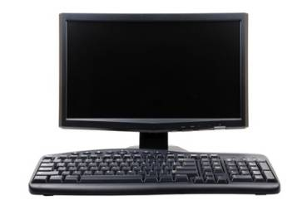
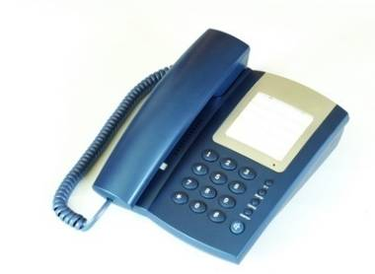


Three Response Modes for Recruitment
Respond by:
1. Mail
2. Online
3. Telephone
Toll-free number
Non-Responders:
Outbound Telephone Recruitment
10
Notes:
10
10
10

Slide 11
Why add Spanish Language Capability?
  The U.S. is the 4th largest Spanish-speaking country in the world
  There are 45 million Latinos in the U.S.
    33 million adults (age 18+)
    38% of Latino adults speak English very little or not at all*
  Adding Spanish language makes Latino sample representative
  Only 56% of Latinos use the Internet - KN enables the other 44% with Spanish configured laptops where needed
50 (2010 Census)
* 2007 Pew Hispanic Center National Survey of Latinos.
11
Notes:
11
11

Slide 12
Selected Funders & Clients
National Cancer Institute
National Institute on Aging
National Institute on Alcohol Abuse and Alcoholism
National Institute of Mental Health
National Oceanic and Atmospheric Administration
National Science Foundation
Centers for Disease Control & Prevention
U.S. Department of Homeland Security
California Department of Human Services
U.S. Bureau of the Census
U.S. Department of Defense
U.S. Department of Veterans Affairs
U.S. Environmental Protection Agency
Numerous universities (e.g., Harvard, Yale, U Penn, et al.)
Foundations/not-for-profits
Research Firms (RTI, Westat)
12

Slide 13
KnowledgePanel Data Published in Many Peer Review Journals
Economics
American Economic Journal: Applied Economics
American Economic Review
Journal of Applied Econometrics
Journal of Risk and Uncertainty
Review of Network Economics
Health & Medicine
Alcoholism: Clinical and Experimental Research
Archives of Internal Medicine
Archives of Pediatric Adolescent Medicine
American Journal of Medicine
American Journal of Preventive Medicine
American Journal of Public Health
Health Affairs
Health Services Research
Journal of Adolescent Health
Journal of the American Dietetic Association
Journal of the American Medical Association (JAMA)
Journal of Clinical Epidemiology
Journal of Clinical Oncology
Journal of Sexual Medicine
Journal on Women’s Health
Menopause
Morbidity & Mortality Weekly Report (CDC)
New England Journal of Medicine (NEJM)
Pediatrics
Vaccine
Psychology
Annual Review of Psychology
Archives of General Psychiatry
Journal of Aggression, Maltreatment & Trauma
Journal of Applied Social Psychology
Journal of Consulting and Clinical Psychology
Journal of Cross-Cultural Psychology
Journal of Personality and Social Psychology
Psychological Science
Political Science
American Journal of Political Science
American Political Science Review
Journal of Politics
Political Analysis
Political Behavior
Political Psychology
Political Research Quarterly
Political Science Quarterly
PS – Political Science & Politics
Sociology
Criminology
Harvard Law Review
IT & Society
Journal for the Scientific Study of Religion
Journal of Marriage and Family
Social Research
Social Science & Medicine
13

Slide 14
LGB Online Surveys on KnowledgePanel
Weighting & Estimation Solutions

Slide 15
Recent KnowledgePanel Surveys of LGB Population
Study | Interview Sample Sizes | Study Goals | Target Population | CalibrationWeighting?
Pew Research LGBT Survey, 2013 | 1,197 | Interview LGBTs on topics related to then upcoming Supreme Court reviews/decisions related to LGBT relationships | General population of self-identified LGB adults | No
National Survey of LGBT People on the ACA, 2013 (Federal sponsor) | 867 | Understand LGBTs’ experiences with health insurance and perceptions of the ACA | Self-identified LGBT under 400% FPL | Yes
Sexuality Survey, 2012 (University sponsor) | 1,076 | Covered a variety of topics related to sexual health and sexual experiences | LGBTs aged 18-60 | No
LGBT Survey, 2012 (Non-Profit Research Center) | 992 | Understand LGBTs’ experience of work life such as working with management, career progress as well as discrimination and mentoring | Self-identified LGBTs aged 21-64 who hold a 4-year degree or higher and who are currently employed in a “white collar” job | Yes

Slide 16
Knowledge Panel’s Profile Question Identifying LGB Status
Do you consider yourself to be…
1. Heterosexual or straight
2. Gay
3. Lesbian
4. Bisexual
5. Other, please specify

Slide 17
Four Surveys, Four Different Screening Questions to Identify the LGB Population
Pew’s Wording
Study 3
Do you consider yourself to be…
1 Heterosexual or straight
2 Gay
3 Lesbian
4 Bisexual
Which of the following commonly used terms best describes your sexual orientation?
Straight/heterosexual (not gay)
Gay, lesbian, or homosexual
Bisexual
Asexual (I am not sexually attracted to others)
Other, please describe [textbox]
Study 2
Do you consider yourself to be:
Heterosexual or straight
Gay
Lesbian
Bisexual
Other [textbox]
Study 4
Do you consider yourself to be…
Heterosexual or straight
Gay
Lesbian
Bisexual
Other, please specify [textbox]
Notes:
Pew’s wording
-No “other option offered”
-Transgender status asked on the same screen
-If a respondent did not reconfirm profile status, they were asked specifically about how they had previously identified
PerryUndem’s wording
-Matched profile categories
IU’s wording
-Grouped “gay” and “lesbian” together with “homosexual”
-Included “not gay” in heterosexual option17171717
-Included an “Asexual” response category
-Wording acknowledges that these terms may be limiting, not an exact match to the respondent’s identity
CTI’s wording
-Question was fielded to highly educated, white collar employed individuals

Slide 18
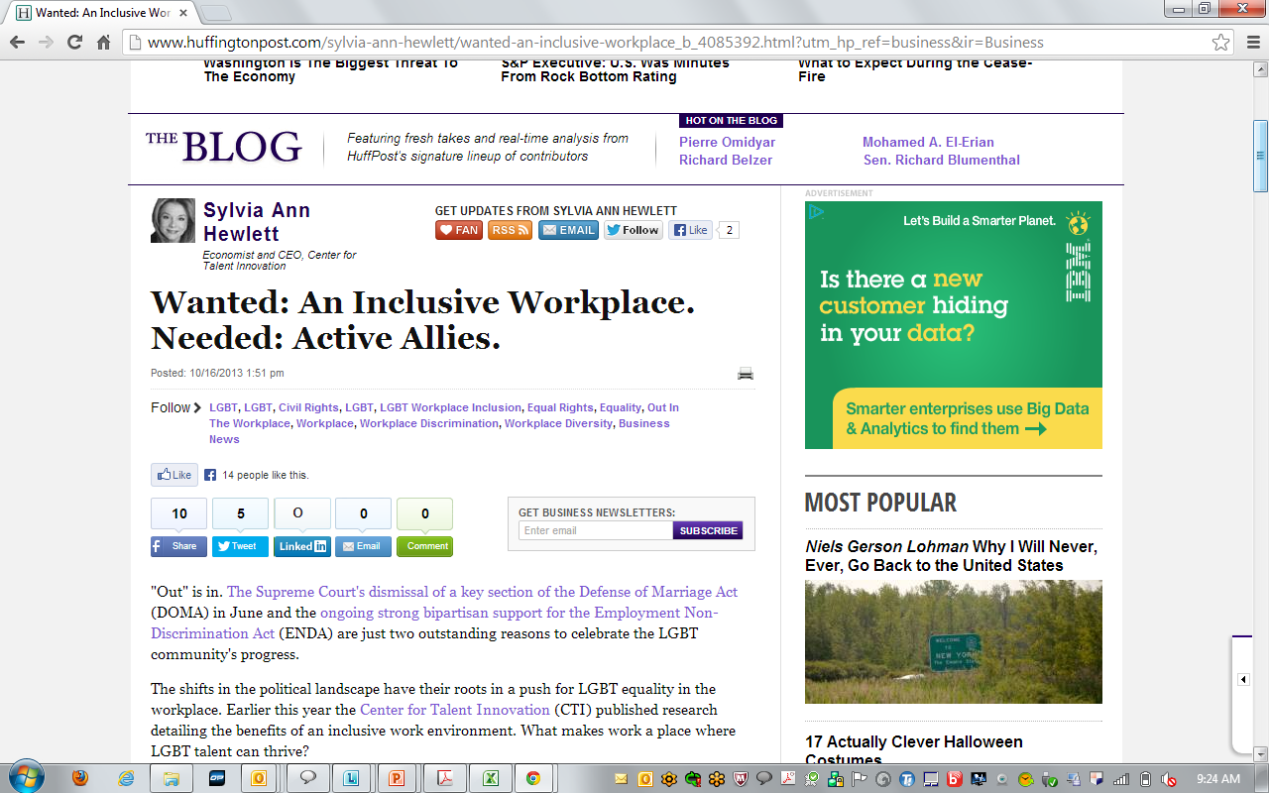
Today’s Thought Piece in the Huffington Post

Slide 19
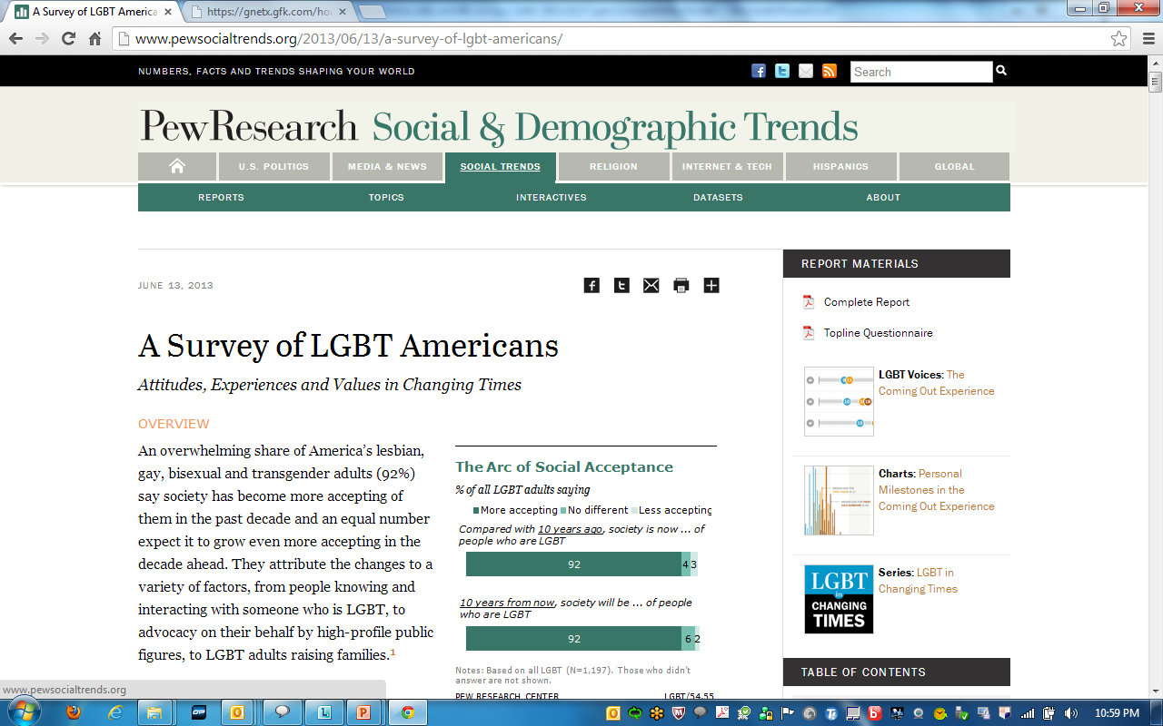

Slide 20
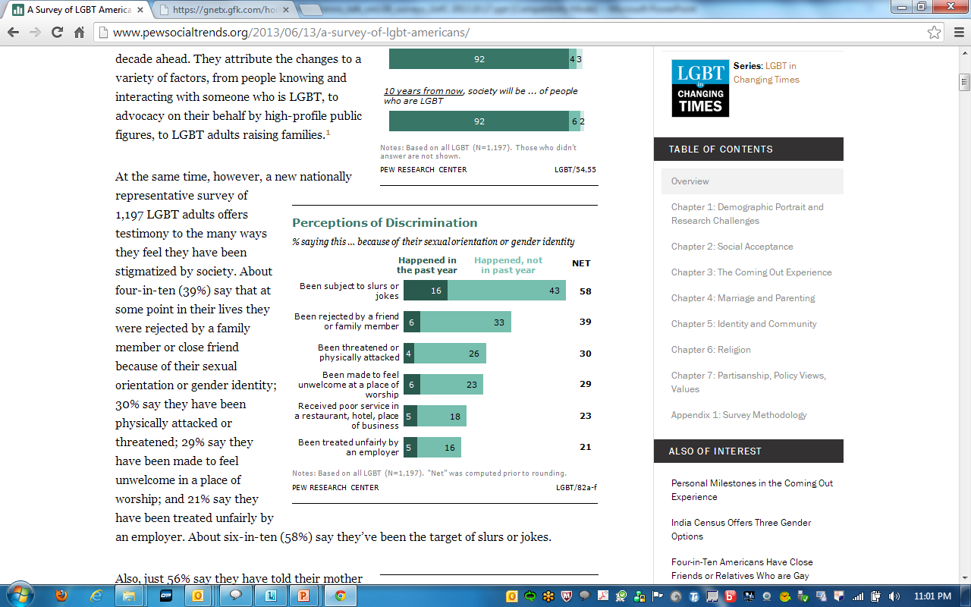

Slide 21
Developing a Weighting Solution for Pew Research Survey on the LGB Population
Pew study to survey a representative sample of LGB adults.
Issue → Absence of definitive benchmarks for the LGB population
For most populations without external benchmarks, GfK weights KnowledgePanel to Census demographic benchmarks and lets the proportions of the study population demographics form the benchmarks
    Problem: We could not rely on the KnowledgePanel profile data to establish the population benchmarks for the LGBT population.

Slide 22
Confirming LGB Status: Unreliability in Measuring LGB Status over Time
  We observed some unreliability in the survey responses to the LGBT eligibility question.
  The online sample consisted of KnowledgePanelists previously profiled to have LGB status.
  Of those Pew survey respondents interviewed, almost 15% did not confirm their LGB status in the Pew Survey. Why? Bisexuals less likely to re-confirm; Pew used a different screening question (no “Other, please specify” response option).
    So what did we do?
    We made the assumption that some respondents to the KnowledgePanel profile survey were not in fact LGB persons, even though they had previously had answered they were.
GfK then identified the most important predictors for these “false positive” instances where respondents failed to confirm their LGB status in the Pew survey.

Slide 23
Weighting solutions: Pew’s custom benchmarks
Some groups were less likely to confirm their LGB status in the Pew Survey:
Persons with less than High School education
Persons age 60 and older who have Some College +
Misclassified | %
No | 85.2%
Yes | 14.8%
Some college or higher
Misclassified | %
No | 88.9%
Yes | 11.1%
High school or less
Misclassified | %
No | 68.2%
Yes | 32.0%
18-59 years old
Misclassified | %
No | 90.7%
Yes | 9.3%
60+ years old
Misclassified | %
No | 83.6%
Yes | 16.4%

Slide 24
Path to Calculating Population Benchmarks for the LGB Pop
Education | Benchmarks from KnowledgePanel BEFORE Demo Weighting | Benchmarks from KnowledgePanel AFTER Demographic Weighting | FINAL Population Benchmarks after all Corrections
Less than High School | 9.1% | 17.4% | 14.9%
High School Grad | 19.1% | 27.6% | 23.6%
Some college | 39.4% | 30.1% | 33.3%
Bachelor or higher | 32.3% | 24.9% | 28.3%
Weighting had significant impacts on our estimates of the true population characteristics of the LGB population.
Weighting has the effect of bringing down the share of the LGB population that has a college degree
Notes:
Note, LHS/HS panel proportions corrected down to account for higher misclassification among LHS/HS seen in Pew study
Age 60+ adjusted minimally as well

Slide 25
Path to Calculating Population Benchmarks for the LGB Pop
Gender/Age | Benchmarks from KnowledgePanel BEFORE Demo Weighting | Benchmarks from KnowledgePanel AFTER Demographic Weighting | FINAL Population Benchmarks
Male 18-29 | 9.7% | 12.1% | 11.8%
Male 30-44 | 7.7% | 16.3% | 16.9%
Male 45-59 | 12.2% | 14.2% | 15.0%
Male 60+ | 8.9% | 7.4% | 7.4%
Female 18-29 | 29.4% | 19.9% | 18.9%
Female 30-44 | 13.2% | 13.4% | 13.5%
Female 45-59 | 11.6% | 10.2% | 10.4%
Female 60+ | 7.3% | 6.4% | 6.0%
Weighting had significant impacts on our estimates of the true population characteristics of the LGB population. Before weighting, 3 out of 10 LGB adults were female, age 18-29. After weighting, our point estimate is under 2 out of 10.
Notes:
Note, LHS/HS panel proportions corrected down to account for higher misclassification among LHS/HS seen in Pew study
Age 60+ adjusted minimally as well

Slide 26
Confirmation Rates of LGB Status (“Reliability”)
 | Pew | Study 2 | Study 3 | Study 4
Heterosexual | 95% | 96% | NA | N/A
Gay | 93% | 92% | 91%* | 94%
Lesbian | 89% | 93% | 88%* | 92%
Bisexual | 67% | 77% | 79% | 76%
*Gay and Lesbian respondents who selected “Gay, lesbian, or homosexual” were considered to have reconfirmed their sexual orientation.
High reliability rates for Time 1 versus Time 2 LGB status responses, with notable exception of bisexual group.

Slide 27
Blending Probability and Non-Probability Online Samples for Online Surveys
Improving Survey Estimates through “Calibration Weighting”

Slide 28

What is Calibration Weighting?
Useful in blended-sample surveys combining probability and non-probability online samples
Combines data from different sources and uses estimates from one source as “benchmarks” to “calibrate” the non-probability survey data.
  Integrates auxiliary information irrespective of relationship to other variables
  (Reuda et al. 2007)
  Reduction of bias (non-response, coverage, measurement error)
  (Kott 2006; Skinner 1999)
  Efficient for limited time-frames, resources (a lower analyst burden)
  Can be used for any variable of interest if:
        differential mode effects are avoided
        opt-in sample uses quotas to control for demos and impact on weights
        identified characteristics differentiate opt-in from probability samples
Rueda, M., et al. (2007). Estimation of the distribution function with calibration methods. J Stat Plan Inference 137(2): 435–448.
Kott, P. (2006). Using calibration weighting to adjust for nonresponse and coverage errors. Survey Methodology, 133–142.
Skinner, C.J. (1999). Calibration weighting and non-sampling errors. Research in Official Statistics, 2, 33-43.
28

Slide 29
Calibration: Study 2 of Lower-Income LGB for ACA Roll-Out
Have you ever felt discriminated against by insurance companies because of your sexual orientation? | KnowledgePanel | Opt-in Online | KnowledgePanel Calibrated
Yes | 13.9% | 23.6% | 16.8%
No | 85.9% | 76.4% | 83.2%
How important is it that the person you might get help from [regarding insurance obtained through the ACA] understands LGBT issues around insurance? | KnowledgePanel | Opt-in Online | KnowledgePanel Calibrated
Very important | 26.3% | 39.5% | 30.9%
Somewhat important | 33.7% | 36.5% | 36.6%
Not too important | 25.9% | 17.1% | 22.2%
Not at all important | 13.5% | 6.9% | 9.7%

Slide 30
Calibration: Study 2 on Lower-Income LGB for ACA Roll-Out
How often do you use the Internet? | KnowledgePanel | Opt-in Online | KnowledgePanel Calibrated
Every day | 73.4% | 91.4% | 71.7%
Almost every day | 16.5% | 5.3% | 14.1%
Several times a week | 5.7% | 1.6% | 7.2%
About once a week | 2.1% | 0.0% | 3.3%
Once or twice a month | 0.4% | 0.3% | 0.3%
Less often | 0.7% | 0.3% | 1.3%
Never | 1.1% | 0.3% | 1.9%
How often do you smoke cigarettes? | KnowledgePanel | Opt-in Online | KnowledgePanel Calibrated
Every day | 16.3% | 30.3% | 23.1%
Several times a week | 3.4% | 5.9% | 4.3%
About once a week | 1.2% | 2.3% | 3.3%
Less often | 5.2% | 6.9% | 7.3%
Never | 73.4% | 54.6% | 61.9%

Slide 31
Calibration: Study 4 on Work Life for LGB Persons
Have you ever worked or traveled extensively for work in another state/region of the country? | KnowledgePanel | Opt-in Online | KnowledgePanel Calibrated
Yes | 32.1% | 49.1% | 42.4%
No | 67.2% | 50.5% | 57.3%
I am willing to do whatever it takes to get to the top. | KnowledgePanel | Opt-in Online | KnowledgePanel Calibrated
Strongly Disagree | 26.1% | 16.3% | 17.6%
Somewhat Disagree | 43.3% | 38.8% | 39.4%
Somewhat Agree | 23.1% | 33.7% | 32.3%
Strongly Agree | 6.7% | 11.0% | 10.4%

Slide 32
Calibration: Study 4 on Work Life for LGB Persons
Do you have at least one senior advocate who is willing to use his/her power and influence to advance your career? | KnowledgePanel | Opt-in Online | KnowledgePanel Calibrated
Yes | 41.8% | 52.1% | 46.0%
No | 56.7% | 47.7% | 53.6%
Does your company offer the health insurance benefits their partners and families for LGB employees? | KnowledgePanel | Opt-in Online | KnowledgePanel Calibrated
Yes | 57.5% | 58.5% | 59.3%
No | 26.9% | 28.3% | 25.7%
Don’t Know | 14.2% | 12.5% | 14.2%

Slide 33
Summary of Main Points

Slide 34
Summary
Statistically valid online survey samples for the LGB population are supported on KnowledgePanel
LGB studies requiring large samples or oversamples of LGB subpopulations can use a blended-sample solution involving calibration weighting.
      The probability-based sample is used to correct sample and non-sample error in the non-probability sample sources.
Research on optimizing the screening question for identifying the LGB population would be useful.
R&D on weighing solutions for LGB pop surveys is just beginning and will be pursued further

Slide 35

Discussion
Mike.Dennis@GfK.com

