Slide 1
The Biopsychosocial Impact Of Aging On Sexual Risk Behaviors Among Women With And Without
HIV-1 Infection
Tonya N. Taylor, PhD, MS
SUNY Downstate Medical Center
The 8th Annual Chicago Workshop on Biomarkers in Population-Based Health and Aging Research: "The Biosocial Study of Health and Aging in Lesbian, Gay, Bisexual, and HIV Affected Populations.”

Slide 2
% of all PLWH in the US by Age Group for 2010
CDC Surveillance Data
Est 2015 54.9 % (35.20% +19.70 %)
Est 2020 70.9 % (54.9 % + 16.01 %)

Slide 3
Background
Sexual activity, both safe and unsafe, declines with age
(Lindau et al, 2007; Reece et al, 2010; Schick et al, 2010).
HIV-infected older adults engage in unprotected anal or vaginal intercourse
(ROAH Study, Karpiak et al, 2006; Golub et al, 2010).
  Certain psychosocial and interpersonal factors affect sexual risk behaviors among older adults with HIV.

Slide 4
Prevention Needs of Older Women with HIV
Little is known about how gender and age-related physical and psychosocial changes impact sexual health and sexual risk behavior
Identification of these factors can provide important background for the development of interventions designed to meet the needs of older women with HIV in the U.S
Urgent attention is needed to understand how biologic events such as, menopause and other life course changes affect the wellbeing of older women with HIV

Slide 5
Women’s Interagency
HIV Study (WIHS)
The largest longitudinal cohort study of HIV-infected women in the United States
Six sites (Washington, DC; San Francisco; Los Angeles; Brooklyn; Bronx; and Chicago).
Enrollments in 1994-95, 2001-02.
Semiannual study visits include:
  Standardized, interviewer-administered questionnaires
  Physical and gynecological examinations and biosamples
Notes:
WIHS is a multicenter, prospective study established in 1993 to investigate the course of HIV infection in women aged 18 years old and older in the United States. WIHS participants were drawn from six consortia
The WIHS initially enrolled women in 1994-95, with a second recruitment phase in 2001-02.
Limitations
Only a few sexual risk behaviors measures were obtained at each semiannual study visit, limiting our ability to examine additional sexual risk patterns such as partner concurrency, and the HIV serostatus of sexual partners. Consequently, we were unable to directly assess risk of HIV transmission.
We used self-report data to categorize sexual risk behaviors and menopausal status and there is always a risk of underreporting.
Participants were recruited from urban sites, so the applicability of our findings to non-urban populations remains unclear.
96% of WIHS at the Brooklyn, Bronx and Chicago sites speak English; therefore, these findings might not capture the HIV prevention needs of the linguistically marginalized population of older women with HIV.
Despite these shortcomings, no other data set can identify longitudinally intra-individual changes in sexual risk behaviors among women with HIV.

Slide 6
Today’s Presentation
Study 1
Longitudinal analysis of sexual activity (SA) and unprotected anal and vaginal intercourse (UAVI) using extant data from the WIHS
Study 2
Prospective cross-sectional survey to assess the impact of certain psychosocial and interpersonal variables on sexual activity (SA) and unprotected anal and vaginal intercourse (UAVI).

Slide 7
Study 1
We examined the associations of age and menopause with sexual activity (SA) and unprotected anal or vaginal intercourse (UAVI) among HIV-infected and HIV-uninfected women over 13 years of follow-up.
We also explored how certain psychosocial, behavioral and clinical factors affect the relationship between age and menopause, as well as SA and UAVI.
Notes:
To explore the relationship between aging, SA and UAVI among women with HIV, this study examined data from the Women's Interagency HIV Study (WIHS), the largest longitudinal cohort study of HIV-infected and uninfected women in the United States.
We examine the associations between aging, menopause and sexual behavior among HIV-infected and HIV-uninfected women over 13 years of follow-up (1998-2011) to determine how aging affects sexual behaviors.

Slide 8
Study 1 Hypotheses
Among both HIV+ and HIV- women, older age is associated with an overall decrease in sexual activity and sexual risk behavior.
Women with HIV-infection will show a greater decline in sexual activity and sexual risk behavior as they age, as compared to HIV-negative women.
Among HIV-infected women, the impact of age on sexual risk behavior will be lower

Slide 9
Methods:
  We separately assessed the impact of age and menopause on SA and UAVI among all participants, and stratified by HIV clinical group
      Age and menopause were not included in the same models
      UAVI analysis was limited to those visits where there was reported SA.
Generalized mixed linear models were fitted for each outcome, adjusted for relevant covariates.
Notes:
We separately assessed the impact of aging and menopause on SA and UAVI among all participants, and stratified by detectable viral load for HIV-infected women.
Generalized mixed linear models were fitted for each outcome, adjusted for relevant covariates.
We analyzed data from 62,721 WIHS person-visits representing 3,818 women over 13 years of follow-up.
We retained 39,812 person-visits, contributed by 1,927 HIV-infected and 742 HIV-uninfected.

Slide 10
Variables
Outcomes
  Sexual activity (SA )
  Unprotected anal or vaginal intercourse (UAVI)
Aging predictors
  Chronological age
  Self-reported menopause
Viral load suppression
  VL- (RNA Undetectable); VL+ (RNA Detectable); HIV-
Covariates & Moderators
  Race, education, current drug and alcohol use, symptoms of depression, quality of life, diabetes, hypertension and duration of follow-up
Notes:
Sexual behavior. At each study visit, women reported if they had vaginal or anal sex and the number of vaginal, anal or oral sex partners during the past 6 months. UAVI was determined based on assessment of condom use consistency (always versus sometimes or never) for vaginal and anal sex separately. Sexually active women who reported sometimes or never to either question about condom use were categorized as having UAVI in the past 6 months.
Aging predictors. Aging was assessed by increased chronological age categorized by decade. Due to irregularities in bleeding patterns, many WIHS participants were not easily categorized via self-report measure for menopause⁴¹. For the purpose of this study we chose a conservative approach for defining the onset of menopause by using self-report data for three consecutive study visits at which no menses were reported during the prior six months. Menopause onset was defined as the date of the second of these three study visits (i.e., 12 months with no menses).
Viral load suppression. Plasma HIV-1 RNA quantification was performed using the isothermal nucleic acid sequence-based amplification method in laboratories certified by the National Institutes of Health Virology Quality Assurance program, with a lower limit of detection set at 48 copies / milliliters (mL). Presence of detectable plasma HIV-RNA among HIV infected women was designated as HIV+/RNA+, versus HIV+/RNA- in those with non-detectable HIV-RNA. Viral load status was imputed for up to two consecutive visits at which HIV-1 RNA was not recorded if the status at the previous visit was the same for the subsequent visit.
Covariates. At enrollment, WIHS participants provided information about their age (continuous), race/ethnicity (Black, White, Latina, or other) and educational attainment (less than high school versus high school or higher).
Moderators. Quantity and frequency of drug and alcohol use, overall Center for Epidemiologic Studies-Depression (CES-D) scale,⁴² quality of life (QoL) summary index ,⁴³ gynecological pathology (e.g., self reported incident cervical, uterine, ovarian or breast cancer), age-related co-morbidities (e.g., incident diabetes or hypertension) and duration of follow-up were included as covariates in our models. Frequency of drug use was assessed via self-reported use of crack, cocaine, heroin, or other injection drugs in the previous 6 months (Y/N). Alcohol use was dichotomized as heavy (≥7 drinks/week) versus light/moderate (<7 drinks/week).⁴⁴
CES-D scores were dichotomized, with ≥16 indicating depressive symptoms⁴⁵. QoL index scores were continuous, ranging from 0-100, with 100 representing the highest perceived quality of life.⁴⁶ Hypertension was defined at each study visit as having one of the following: diastolic blood pressure ≥90mmHg; systolic blood pressure ≥140mmHg; or current receipt of antihypertensive medication(s).⁴⁷ Diabetes mellitus (DM) was determined based on either fasting glucose ≥126 mg/l, or self-reported DM or anti-diabetic medication use.⁴⁸

Slide 11
Sample
We analyzed data from over 62,721 WIHS person-visits representing almost 3,818 women over 13 years of follow-up
Excluded visits with: HIV-seroconversion, hysterectomy or oophorectomy , pre-HAART era, pregnant or trying to get pregnant
For menopause, we limited analysis only to those visits where women were between 40-57 years
We retained 39,812 person visits, contributed by 1,927 HIV-infected women and 742 HIV-uninfected women

Slide 12
Sample characteristics at enrollment
 | VL+ N=1371 | VL- N=556 | HIV− N=742 | p-value
Age (Median age) | 37 | 37 | 34 | <.0001
18-29 30-39 40-49 50-59 60+ | 18% 46% 32% 4% 0.5% | 20% 45% 28% 6% 0.5% | 37% 38% 22% 3% 0.4% | <.0001
Race White Hispanic Black | 14% 26% 58% | 17% 33% 47% | 13% 27% 56% | 0.0020
Education ≥HS | 62% | 60% | 65% | 0.1423
Notes:
Explain columns before presentation data
Baseline characteristics of the study population, stratified by HIV status, are shown at the top of Table 1.
The majority of the participants were ≥30 years old, Black, and had more at least a high school education.
The majority of participants were sexually active, with the HIV-uninfected women reporting more SA (87%) than the VL+ (74%) or VL- (73%) HIV-infected women (p<0.0001).
More than a quarter of the VL+ (29%) and VL- (28%) women reported UAVI. The HIV-uninfected women, however, reported twice (60%) as much UAVI as did women with HIV (p<0.0001).

Slide 13
Psychosocial and clinical characteristics across 13 years of follow up

Slide 14
Any SA at enrollment and across 13 years follow up

Slide 15
Any UAVI at enrollment and across 13 years follow up

Slide 16
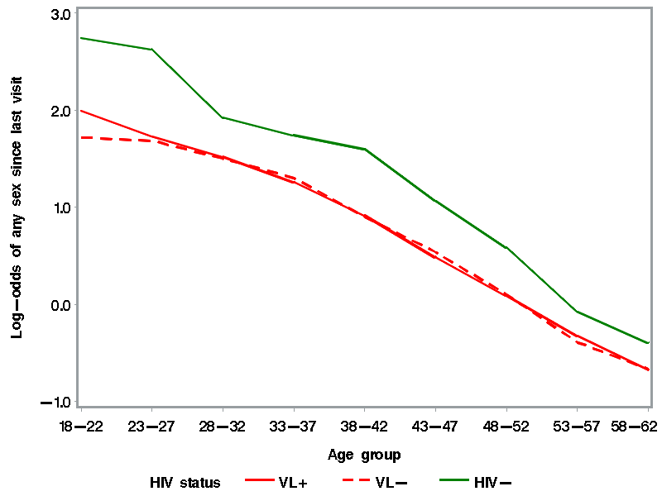
Linearity of relationship of age to log-odds of SA
Notes:
The first step in our analysis was modeling the functional relationships of age with outcome variables (SA, UAVI)
To examine the plausibility of linear relationships with age and SA and UAVI, we divided the observations into 5-year age groups, and estimated log-odds ratio for each of these age groups relative to the youngest (18-22).
The effect was reasonably linear until we get to the last two groups (68+), where there are very few observations in those oldest groups (0.3% combined) to render a precise estimate.
The plot of model-estimated log-odds indicates that although linearity does not strictly hold, a simple linear term in age should account for the majority of its association with SA.

Slide 17
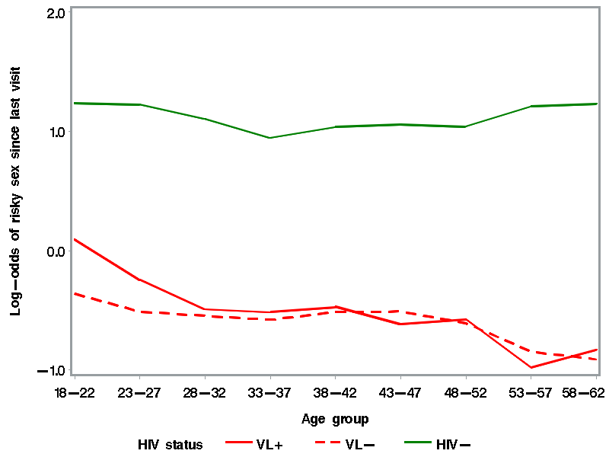
Linearity of relationship of age to log-odds of UAVI
Odds of UAVI declined by 15% per decade for VL+ , 7% for VL- and 3% for HIV-women. The decline significant for HIV+ women (p=0.028) but not HIV- (p= 0.065).
Notes:
The model the linear relationship of UAVI with age is shown in Figure 2.
Excluding visits beyond age 62, the plot of model-estimated log-odds suggest that linearity also provides a reasonable model for the association of UAVI with age.

Slide 18
Decline of SA with menopause was only significant for women with HIV
Group | OR | 95% CI
HIV+/VL+ | 0.78 | 0.68- 0.91
HIV+/VL- | 0.75 | 0.65- 0.88
HIV- | 0.82 | 0.64- 1.05
Notes:
Adjusted ORs of any SA by menopause, stratified by HIV status, are shown in Table 3.
There were no statistically significant effect modifiers. The odds of any SA in a 6-month interval for women aged 40-57 declined by 18-25% after menopause.
There were no statistically significant effect modifiers. The adjusted odds ratios for any SA associated with menopause were statistically significant for the women with HIV (HIV+/RNA+ OR: 0.78; 95% CI: 0.68-0.91 and HIV+/RNA - OR: 0.75; 95% CI: 0.65-0.88).

Slide 19
Summary
  Older age was associated with an overall decrease in SA and UAVI for both HIV-infected and HIV-uninfected women
    The decline in SA was independent of HIV status.
    The impact of menopause on the decline of SA was significant only among women with HIV.
  HIV-uninfected women maintained higher levels of both SA and UAVI over time than the HIV-infected women.
  More than two-thirds of the HIV-infected women in the WIHS were sexually active, and 22-25% engaged in UAVI over 13 years of follow-up
Notes:
Older age was associated with an overall decrease in sexual activity (SA) and unprotected anal or vagina intercourse (UAVI) among both HIV-infected and HIV-uninfected women, after accounting for health status, alcohol use, substance use, and depressive symptoms.
We did not find that women with HIV showed a greater decline in SA as they aged, as compared to HIV-uninfected women.
In this study, regardless of serostatus/viral load, SA declined by 60% per decade of age for non-drug users and almost 70% per decade of age for drug-users.
For women aged 40-57, SA declined by 18-25% after menopause.
Although the odds ratios for any SA associated with menopause were statistically significant for the women with HIV we cannot definitively assert that there is any menopause effect among the HIV- women due to the slightly higher estimate and smaller sample size.
In this study, regardless of serostatus/viral load, SA declined by 60% per decade of age for non-drug users and almost 70% per decade of age for drug-users. For women aged 40-57, SA declined by 18-25% after menopause. Although the odds ratios for any SA associated with menopause were statistically significant for the women with HIV we cannot definitively assert that there is any menopause effect among the HIV- women due to the slightly higher estimate and smaller sample size. The odds of any UAVI in a 6 month interval declined by about 20% per each decade of age for HIV+/RNA+ hypertensive and normotensive women and HIV+/RNA- hypertensive women. Poor health and certain comorbid conditions such as hypertension physiologically effect sex drive and have been found to be associated with a decline in SA among older adults.^{15,34,35} Poor viral load suppression and comorbidities may similarly affect UAVI. Finally, UAVI significantly declined among depressed HIV+/RNA- women. A plausible conclusion might be that menopause exerts a braking effect on risky sex only among those with measurable HIV viremia and depression.

Slide 20
Study 2
Prospective study to identify clinical, psychological and interpersonal factors that impact the sexual risk behaviors of older women with and without HIV-1 infection
Hypotheses:
  H1. Among both HIV+ and HIV- women, an increase in age will be associated with a decline in sexual health and an increased burden of sexual dissatisfaction, isolation, and loneliness.
  H2. Among older women with HIV, increases in sexual risk behavior will be associated with partnership characteristics, and increased isolation, loneliness, non-disclosure.

Slide 21
Methods (1)
Administered a 30-item survey to all WIHS participants across all 6 WIHS sites during their regular study visit between April-September, 2012
Participants were stratified by clinical group (HIV+ viral load detectable, HIV+ viral load undetectable and HIV-) and age quartiles (<41; 41-48; 49-54; >54)
The prevalence of unprotected anal or vaginal sex was assessed within each clinical and age group.
Notes:
This survey include selected items NCHAP survey and from the following 3 validated measures.
Duke Social Support (Berkman et al, 2003)
UCLA 3-item Loneliness scale (Hughes et al, 2004)
Brief Disclosure and Safer Sex Scale (Kalichman et al, 2005)
This survey provided supplementary information on topics linked to sexual risk behavior that are not currently collected in WIHS.

Slide 22
Methods (2)
We performed the Mantel-Haenszel chi-square test to assess trends in sociodemographic, lifestyle, psychosocial and medical history characteristics across age categories.
Notes:
This survey include selected items NCHAP survey and from the following 3 validated measures.
Duke Social Support (Berkman et al, 2003)
UCLA 3-item Loneliness scale (Hughes et al, 2004)
Brief Disclosure and Safer Sex Scale (Kalichman et al, 2005)
This survey provided supplementary information on topics linked to sexual risk behavior that are not currently collected in WIHS.

Slide 23
Additional Variables
  Duke Social Support (Berkman et al, 2003)
    3 levels (Overall, Relative and Friend); cutoff scores = <12 indicated at risk of social isolation; <6 indicated low Relative and Friend support
  UCLA 3-item Loneliness scale (Hughes et al, 2004)
    Range: 3-9; high score indicated risk for loneliness
  Brief Disclosure Self-Efficacy Scale (Kalichman et al, 2005)
    Sub-scale administered with safer sex scale; range 5-20; higher score indicates high disclosure self-efficacy
  Partner characteristics
    Type of partnership, partner’s relative age, partners age, sexual satisfaction, sexual function, selected items NCHAP survey
  VACS index (Justice et al, 2011)
Notes:
Sexual behavior. At each study visit, women reported if they had vaginal or anal sex and the number of vaginal, anal or oral sex partners during the past 6 months. UAVI was determined based on assessment of condom use consistency (always versus sometimes or never) for vaginal and anal sex separately. Sexually active women who reported sometimes or never to either question about condom use were categorized as having UAVI in the past 6 months.
Aging predictors. Aging was assessed by increased chronological age categorized by decade. Due to irregularities in bleeding patterns, many WIHS participants were not easily categorized via self-report measure for menopause⁴¹. For the purpose of this study we chose a conservative approach for defining the onset of menopause by using self-report data for three consecutive study visits at which no menses were reported during the prior six months. Menopause onset was defined as the date of the second of these three study visits (i.e., 12 months with no menses).
Viral load suppression. Plasma HIV-1 RNA quantification was performed using the isothermal nucleic acid sequence-based amplification method in laboratories certified by the National Institutes of Health Virology Quality Assurance program, with a lower limit of detection set at 48 copies / milliliters (mL). Presence of detectable plasma HIV-RNA among HIV infected women was designated as HIV+/RNA+, versus HIV+/RNA- in those with non-detectable HIV-RNA. Viral load status was imputed for up to two consecutive visits at which HIV-1 RNA was not recorded if the status at the previous visit was the same for the subsequent visit.
Covariates. At enrollment, WIHS participants provided information about their age (continuous), race/ethnicity (Black, White, Latina, or other) and educational attainment (less than high school versus high school or higher).
Moderators. Quantity and frequency of drug and alcohol use, overall Center for Epidemiologic Studies-Depression (CES-D) scale,⁴² quality of life (QoL) summary index ,⁴³ gynecological pathology (e.g., self reported incident cervical, uterine, ovarian or breast cancer), age-related co-morbidities (e.g., incident diabetes or hypertension) and duration of follow-up were included as covariates in our models. Frequency of drug use was assessed via self-reported use of crack, cocaine, heroin, or other injection drugs in the previous 6 months (Y/N). Alcohol use was dichotomized as heavy (≥7 drinks/week) versus light/moderate (<7 drinks/week).⁴⁴
CES-D scores were dichotomized, with ≥16 indicating depressive symptoms⁴⁵. QoL index scores were continuous, ranging from 0-100, with 100 representing the highest perceived quality of life.⁴⁶ Hypertension was defined at each study visit as having one of the following: diastolic blood pressure ≥90mmHg; systolic blood pressure ≥140mmHg; or current receipt of antihypertensive medication(s).⁴⁷ Diabetes mellitus (DM) was determined based on either fasting glucose ≥126 mg/l, or self-reported DM or anti-diabetic medication use.⁴⁸

Slide 24
Cross-sectional survey sample
By age:
all women across all 6 sites
Women 50+ by clinical group
Total (N=2052)
61% SA (n = 1246)
28% UAVI (n = 569)
Total N=789
41% SA (N= 323)
21% UAVI (n=169)

Slide 25
Demographic characteristics of all women across age groups
 |  | ≤40 (N=505) | 41-<48 (N=554) | 48-<54 (N=504) | ≥54 (N=510) | P-value
Age | Median | 36 | 45 | 51 | 58 | <.0001
Marital status | Married/common law Widow/divorce/separated Single | 40% 11% 41% | 32% 25% 32% | 33% 27% 24% | 23% 43% 21% | ns
Education | HS+ | 60% | 59% | 63% | 68% | 0.0016
Race/ Ethnicity | White Hispanic Black | 7% 31% 58% | 10% 26% 60% | 13% 25% 58% | 14% 22% 62% | 0.0314
Employment | Yes | 47% | 41% | 32% | 26% | <.0001
Income | ≤ 12K >12K-24K >24K-36K >36K | 44% 28% 12% 17% | 49% 24% 11% 16% | 53% 21% 10% 16% | 57% 23% 8% 12% | 0.0002

Slide 26
Demographic characteristics for women 50 + across clinical groups
 |  | VL+ | VL- | HIV- | P-value
Marital status | Married/common law Widow/divorce/separated Single | 24% 38% 24% | 31% 38% 21% | 27% 37% 23% | ns
Education | HS+ | 68% | 64% | 67% | ns
Race/ Ethnicity | White Hispanic Black | 15% 23% 61% | 17% 26% 53% | 8% 19% 69% | 0.0040
Employment | Yes | 20% | 34% | 29% | 0.0009
Income | ≤ 12K >12K-24K >24K-36K >36K | 64% 19% 7% 10% | 46% 25% 9% 20% | 61% 23% 8% 9% | 0.0006

Slide 27
Sexual activity and UAVI for all women across age groups

Slide 28
Sexual activity and UAVI for women 50+ across clinical groups

Slide 29
Psychosocial & clinical characteristics for all women across age groups

Slide 30
Psychosocial and clinical characteristics for women 50+ across clinical groups

Slide 31
Partner characteristics of all women across age groups
 |  | ≤40 (n=501) | 41-<48 (n=546) | 48-<54 (n=501) | ≥54 (n=505) | P-value
Main sex partner | Ongoing Casual None | 70% 9% 20% | 60% 6% 34% | 49% 5% 46% | 27% 4% 69% | <.0001
Main partner’s relative age | Older Younger Same age | 64% 28% 8% | 63% 30% 7% | 56% 33% 11% | 35% 59% 6% | <.0001
Main partners age | M (SD) | 39(8) | 47 (8) | 52 (7) | 55 (8) | <.0001

Slide 32
Partner characteristics for 50 + across clinical groups
 |  | VL+ (N=228) | VL− (N=345) | HIV− (N=209) | p-value
Main sex partner | Ongoing Casual None | 30% 3% 67% | 35% 3% 63% | 43% 6% 51% | 0.0055
Main partner’s relative age | Older Younger Same age | 46% 43% 11% | 43% 47% 10% | 45% 47% 8% | ns
Main partners age | M (SD) | 54 (7) | 54 (8) | 56 (5) | ns

Slide 33
Sexual satisfaction among sexually active women 50+
 |  | VL+ (N=81) | VL− (N=132) | HIV− (N=105) | p
Satisfaction with sex in past 4 weeks | Satisfied Equally satisfied & dissatisfied Dissatisfied | 79% 7% 14% | 58% 30% 11% | 63% 16% 21% | 0.0332
Satisfaction with relationship in past 4 weeks | Satisfied Equally satisfied & dissatisfied Dissatisfied No partner | 75% 7% 12% 5% | 62% 22% 13% 3% | 62% 16% 18% 4% | ns

Slide 34
Sexual function among sexually active women 50+
 |  | VL+ (N=79) | VL− (N=133) | HIV− (N=109) | P-value
Participant has problems with sex | Yes | 27% | 32% | 18% | 0.047
 |  | VL+ (N=81) | VL− (N=133) | HIV− (N=107)
Partner has problems with sex | Yes No No partner | 17% 80% 3% | 26% 71% 3% | 13% 82% 5% | ns

Slide 35
Social Support for all women across age groups

Slide 36
Social Support for women 50+ across clinical groups

Slide 37
Loneliness and Disclosure for all women across age groups

Slide 38
Loneliness and Disclosure for women 50+ across clinical groups

Slide 39
Discussion (1)
  Among both HIV+ and HIV- women, an increase in age is associated with a decline in sexual activity.
    Decline in sexual activity is independent of HIV status
    HIV+ women have a lower probability of sexual activity than HIV-uninfected women

Slide 40
Discussion (2)
Among both HIV+ and HIV- women, age predicts UAVI but when we control for HIV status there is no significant age effect.
  The probability of UAVI among HIV-uninfected women is almost double that of women with HIV

Slide 41
Discussion (3)
Across all age groups, more than a third of the women were at risk for social isolation and had weaker social support from friends.
Among older women (>54) there was significantly lower SA but no difference in UAVI.
Older women (>54) had a higher burden of loneliness, depression, sexual abuse and higher VACS score.
Younger women had lower levels of disclosure

Slide 42
Discussion (4)
More than a third of women with HIV reported SA and among those HIV+ women who were sexually active, 36-38% reported UAVI.
Across all clinical groups, more than a third were at risk for social isolation.
Women with HIV had a higher burden of loneliness.
HIV+ women reported more sexual dysfunction (especially among VL-); however, VL+ women reported higher levels of sexual satisfaction.

Slide 43
Limitations
Self-reports used to categorize sexual risk behaviors and menopausal status may have been subject to underreporting.
Participants were recruited from urban sites, so the applicability of our findings to non-urban populations remains unclear.
96% of WIHS sites speak English; therefore, these findings might not capture the HIV prevention needs of the linguistically marginalized population of older women with HIV.
Despite these shortcomings, no other data set can longitudinally characterize intra-individual changes in sexual risk behaviors among women with HIV-infection.
Notes:
Only a few sexual risk behaviors measures were obtained at each semiannual study visit, limiting our ability to examine additional sexual risk patterns such as partner concurrency, and the HIV serostatus of sexual partners. Consequently, we were unable to directly assess risk of HIV transmission.
We used self-report data to categorize sexual risk behaviors and menopausal status and there is always a risk of underreporting.
Participants were recruited from urban sites, so the applicability of our findings to non-urban populations remains unclear.
96% of WIHS at the Brooklyn, Bronx and Chicago sites speak English; therefore, these findings might not capture the HIV prevention needs of the linguistically marginalized population of older women with HIV.

Slide 44
Conclusion
The decline in SA and UAVI over time among women with and without HIV was dependent on age.
A quarter of the HIV-infected women in the WIHS engaged in UAVI over 13 years of follow-up.
These findings suggest that as women, with and without HIV, age they may need additional support for maintaining safer sex practices.
Further research and guidance are needed to identify the prevention needs of older women with HIV and at risk for HIV infection.

Slide 45
Contributors
Co-Authors
Jeremy Weedon SUNY-DMC, Brooklyn, NY
Elizabeth T. Golub WDMAC, John Hopkins, Baltimore
Monica Gandhi UCSF Medical Center, San Francisco, CA
Mardge Cohen Hospital of Cook County, Chicago, Ill
Stephen Karpiak ACRIA, Manhattan, NY
Howard Minkoff Maimonides Hospital, Brooklyn, NY
Adebola Adedimeji Albert Einstein College of Medicine, Bronx, NY
Lakshmi Goparaju Georgetown University, Washington, DC
Alexandra Levine USC, Los Angeles, CA
Susan Holman SUNY-DMC, Brooklyn, NY
Tracey E. Wilson SUNY-DMC, Brooklyn, NY

Slide 46
Acknowledgements
This work was supported by the National Institute of Mental Health (1 KO1 MH095670, Taylor, PI).
The WIHS is funded by the National Institute of Allergy and Infectious Diseases (U01-AI-35004, UO1-AI-31834, UO1-AI-34994, UO1-AI-34989, UO1-AI-34993, and UO1-AI-42590) and by the Eunice Kennedy Shriver National Institute of Child Health and Human Development (UO1-HD-32632). The study is co-funded by the National Cancer Institute, the National Institute on Drug Abuse, and the National Institute on Deafness and Other Communication Disorders. Funding is also provided by the National Center for Research Resources (UCSF-CTSI Grant Number UL1 RR024131).

Slide 47
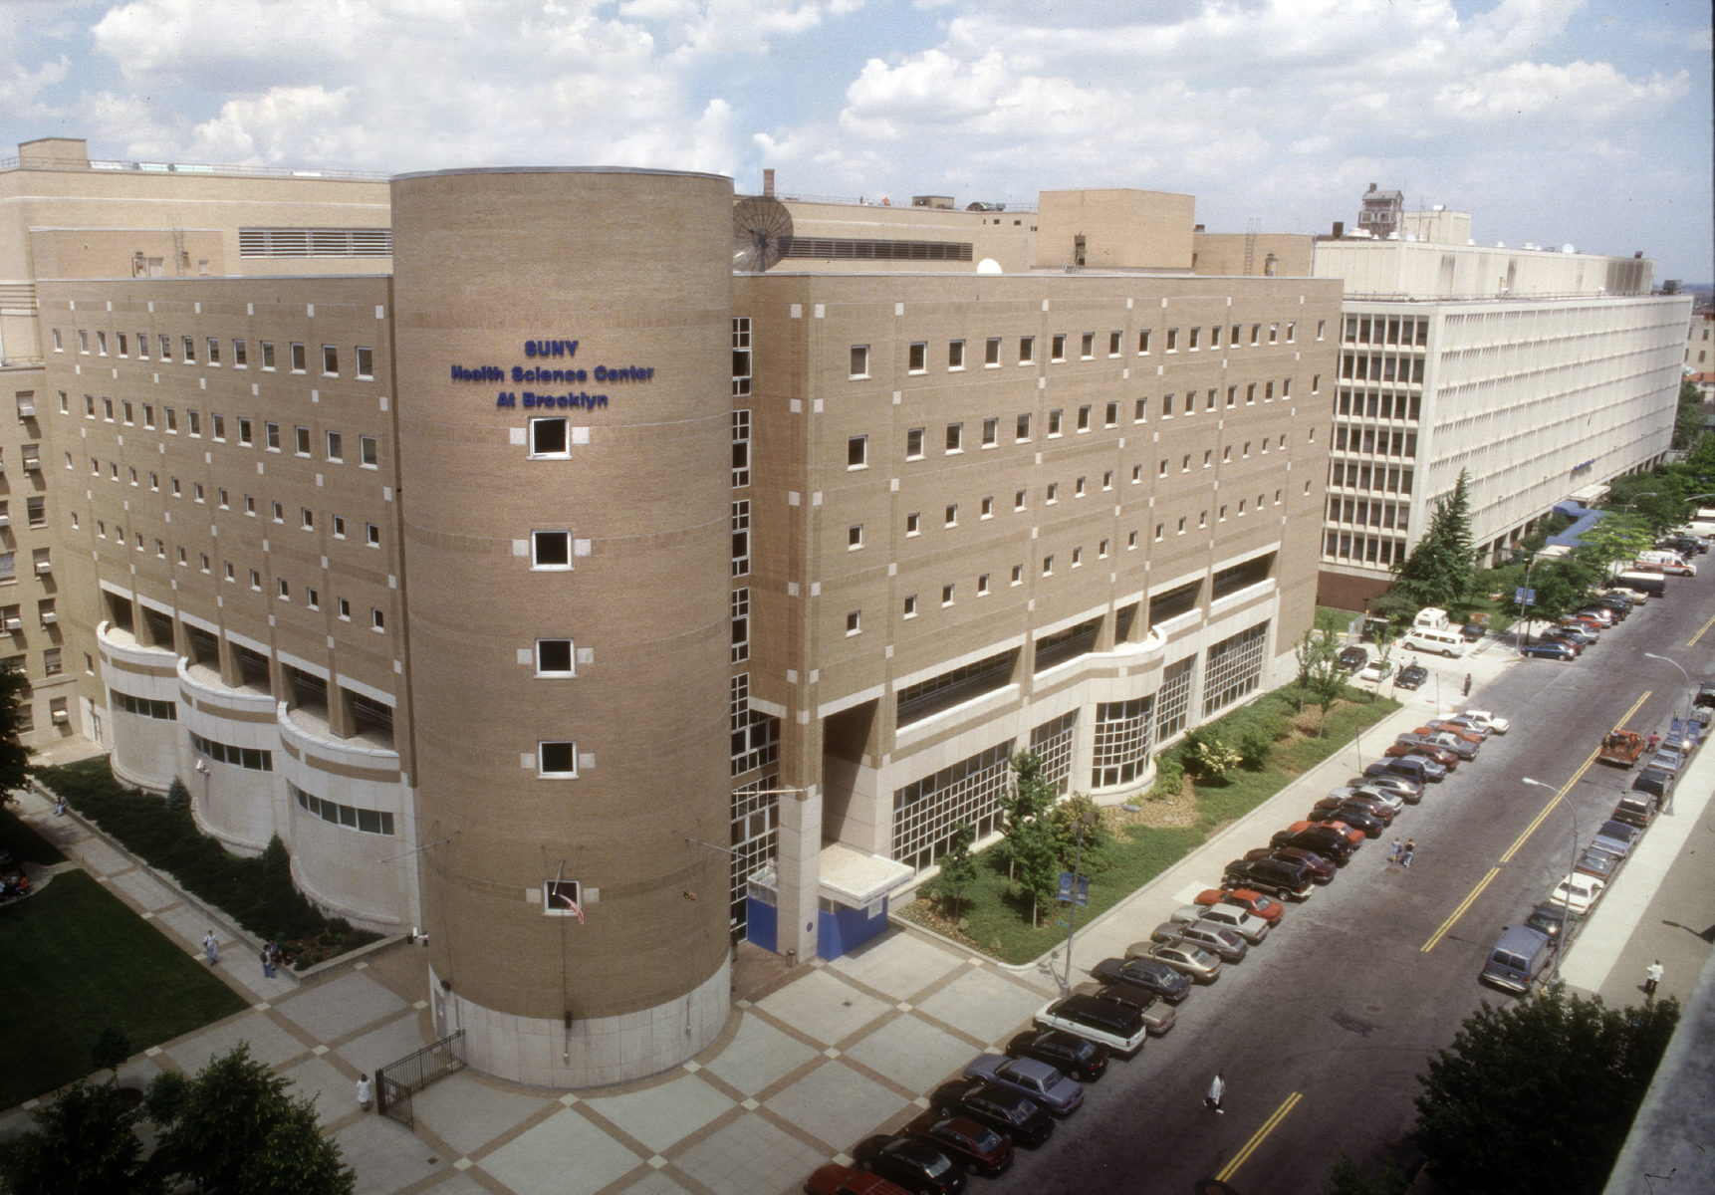
Thank You

